Slide 1
IDIOM Student Research Group
Alexander Gratner
Anqing Duan
Yuchao Li

Slide 2
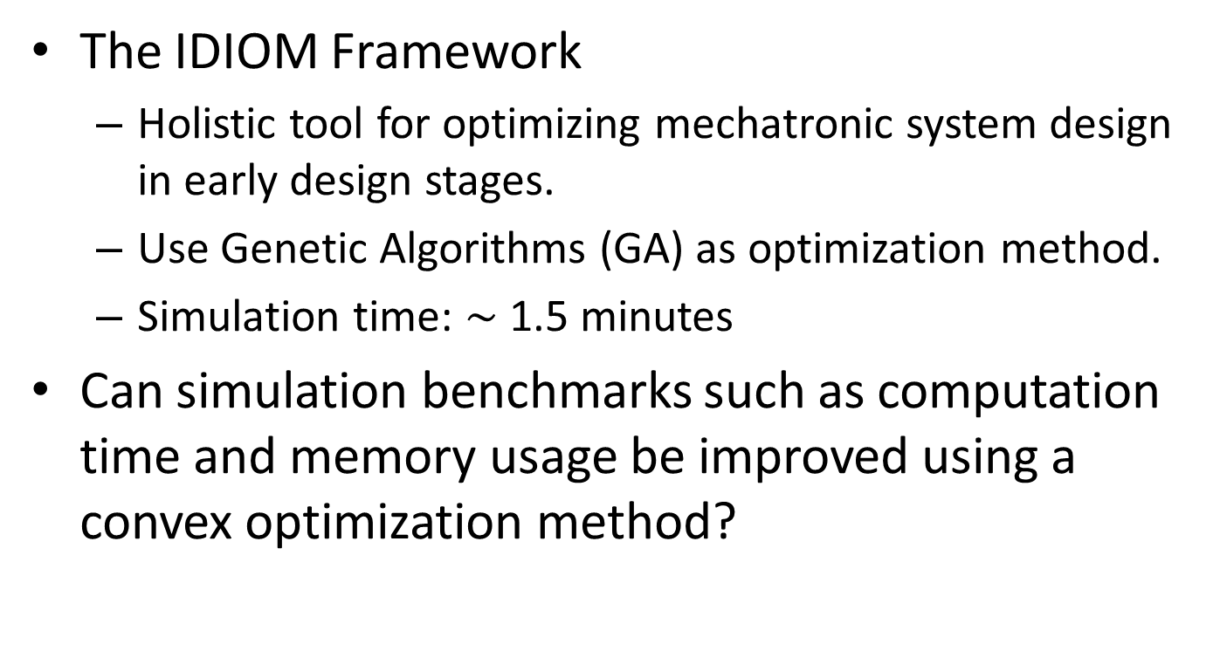
Background
The IDIOM Framework
Holistic tool for optimizing mechatronic system design in early design stages.
Use Genetic Algorithms (GA) as optimization method.
Simulation time: $\sim$ 1.5 minutes
Can simulation benchmarks such as computation time and memory usage be improved using a convex optimization method?
Notes:
The IDIOM framework has been developed by Daniel Malmquist, Daniel Frede and Jan Wikander to enable holistic system design optimization in early design stages of mechatronic systems
It uses genetic algorithms to conduct these optimizations which result in an answer time of approximetly 5 minutes.

Slide 3
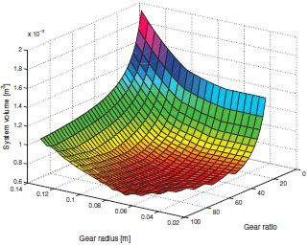
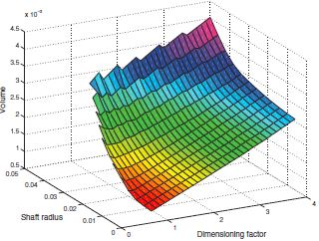
Convex Optimization
Suitable for the context
Gradient based optimization method
Faster computational speed in general
Global optimal achieved
More constraints on the functions

Slide 4
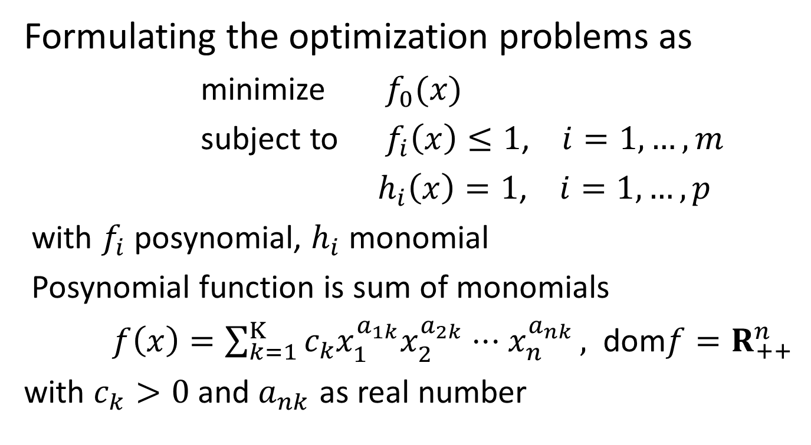
Geometric Program
Formulating the optimization problems as
minimize $f_{0}(x)$
subject to $f_{i}\left(x\right)≤1$, $i=1,…,m$
$h_{i}\left(x\right)=1$, $i=1,…,p$
with $f_{i}$ posynomial, $h_{i}$ monomial
Posynomial function is sum of monomials
$f\left(x\right)=\sum_{k=1}^{Κ}{c_{k}x_{1}^{a_{1k}}x_{2}^{a_{2k}}⋅⋅⋅x_{n}^{a_{nk}}},$ dom$f=R_{++}^{n}$
with $c_{k}>0$ and $a_{nk}$ as real number

Slide 5
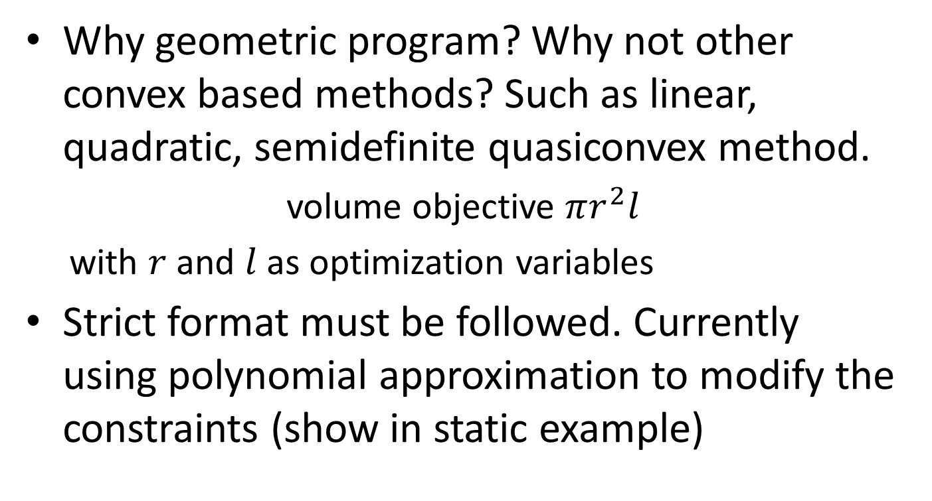
Geometric Program
Why geometric program? Why not other convex based methods? Such as linear, quadratic, semidefinite quasiconvex method.
volume objective $πr^{2}l$
with $r$ and $l$ as optimization variables
Strict format must be followed. Currently using polynomial approximation to modify the constraints (show in static example)

Slide 6
Software Tool
CVX: currently being used. Developed by Stanford University. Problems need to be formulated strictly following the format of geometric program. Initial point is not needed.
fmincon: has been tried. MATLAB built in toolbox. No need for strict function format. Interior-point algorithm, initial point needed.

Slide 7
Function Structure

Slide 8
Static Optimization
Based on the models of IDIOM system
Polynomial approximation for modification
Result comparison
 |  | GA | GP
Motor | Optimal Volume
 | Time
Motor + Gears | Optimal Volume
 | Time

Slide 9
Dynamic Optimization
Result Comparison
notice here the dimensioning factor is not
included.
 | GA | GP
Optimal Volume
Time

Slide 10
Dynamic Constraints
Comprehensive criterion: integrated square error (ISE). Not geometric format, modification needed. Discrete state space model is used to formulate the constraint, as well as whole trajectory if needed.
Pole position needed in advance. Conflict with pole placement.

Slide 11
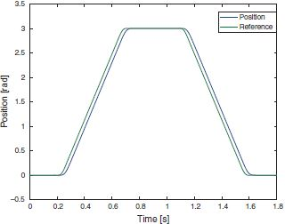
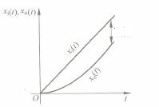
Dynamic Constraints
Simple criteria: Over shoot, Slope delay. Simple form, almost equivalent to ISE, with some loss of detail.
Upper bound of poles (with same position) can be chosen based on delay time. Precise pole placement not solved at this stage.

Slide 12
Shaft Volume
Based on the strategy we use, the shaft volume is around
The data provided is , which gives
Any additional constraint not included?

Slide 13
Dimensioning Factor
Transfer function
Conflict of results
Our approach, only capable for optimal point

Slide 14
Pole Placement
Relations of poles
Conflicting with ISE criterion or trajectory forecasting
Upper bound can be found with slope delay, but not the precise one

Slide 15
Any Questions?

